Slide 1
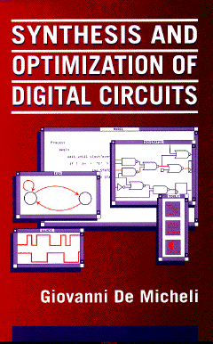


Modeling Languages and Abstract Models
Giovanni De Micheli
Integrated Systems Laboratory
This presentation can be used for non-commercial purposes as long as this note and the copyright footers are not removed
© Giovanni De Micheli – All rights reserved

Slide 2
Module 1
Objective
Modeling requirements in systems
Modeling styles

Slide 3
Electronic systems
A system is a combination of:
Hardware platform:
Processors, memories, transducers
Software :
Application and system software
Attributes:
Application domain
Computing, communication, consumer
Integration level
Chip, board, distributed/networked
Function
Autonomous, embedded
Notes:
Electronic systems are complex. We should never think of a systems as consisting only of hardware. Indeed, systems have an important sotfware part, including application and system (i.e., operating system, RTOS,…) Sw. Systems can be classified in many ways. One possibility is by looking at the application domain. Another, is by looking at its structural properties, i.e., how the systems is composed of parts: there are systems on chips, in boards and distributed systems. When a system is self-standing (i.e. a computer), then we can say it is autonomous. When a system is part of a larger system, we say it is embedded into it. For example, the controller for a car is embedded in the car itself.

Slide 4
Trends and challenges
Design increasingly more complex systems under higher time to market pressure
Raise level of abstraction
Design starts are mainly for embedded system applications
Use and re-use of high-level components
Processors, controllers, embedded memories
Support concurrent Hw/Sw development
System customization via embedded software
Support automated synthesis and verification
Notes:
In most cases designers have to design complex systems rapidly. Thus, if the abstraction level is raised, the time to design is less, and CAD tools take over the task of refining the original specifications. In the recent years, we have seen a decrease of “design starts”, i.e., of new designs even on a world wide basis. Modern design is characterized by the sharing of existing components.
Thus “design reuse” is widely used. Most system design tools are environment supporting the concurrent design of Hw and Sw, and provide support for automated synthesis and verifications.

Slide 5
Embedded systems
EMBEDDED SYSTEM
MEMORY
ISP
SENSORS
ACTUATORS
HARDWIRED UNIT
Application-specific logic
Timers
A/D and D/A conversion
ENVIROMENT
Notes:
This is a schematic picture of an embedded system. The core is build around one or more (instruction set) processors, memory banks and application-specific Hw. This Hw delas often with the handling of timing constraints and with the analog interface. Sensors and actuators are often part of embedded systems.

Slide 6
Embedded system requirements
Reactive systems:
The system never stops
The system responds to signals produced by the environment
Real-time systems:
Timing constraints on task execution
Hard and soft constraints
Notes:
Most embedded systems are reactive. Their mode of operation is reactive, i.e. the system waits for some inputs, does some processing, and goes back to sleep mode while waiting for some more inputs. Often embedded systems work under real time constraints: hard constraints are mandatory timing constraints while soft constraints need only to be satisfied in average (e.g. pages per minute delivered by a printer).

Slide 7
System modeling
Represent system functions while abstracting away unnecessary details
Software programming languages
Hardware description languages
Flow and state-based diagrams
Schematics
No golden solution
System heterogeneity
Notes:
Modeling means finding the appropriate representation for a system, that focuses on the issues at stake. Modeling paradigms include programming languages, hardware description languages or HDLs, flow/state diagrams and schematics. There is no universal modeling scheme, except for very restricted domains. The issue is that systems are heterogeneous, i.e. with different components ov various nature (e.g., analog, digital. RF, …)

Slide 8

The limits of my language mean the limits of my world
Wittgenstein
Notes:
The famous philosopher Wittgenstein (early 1900) explained how the limitations of a language relate to the limitation of communication.
In our case, we cannot synthesize what we cannot express.

Slide 9
Circuit Modeling
Formal methods:
Models in hardware languages
Flow and state diagrams
Schematics
Informal methods:
Principles of operations
Natural-language descriptions
Notes:
Formal models have a well-defined syntax and semantics. Hence they provide a way of conveying the information about a circuit in a consistent way that can be unambiguously interpreted.
Thus automated tools can be designed to read, process and write such models.
Conversely, informal circuit specifications, such as textual descriptions of the principles of operations of a computer in a natural language, have limited applications when CAD methods are used. In addition, informal descriptions of large-scale circuits or systems may be sources of misunderstanding.

Slide 10
Hardware versus software models
Hardware:
Parallel execution
I/O ports, building blocks
Exact event timing is very important
Software:
Sequential execution (usually)
Structural information less important
Exact event timing is not important
Notes:
Let us compare the most distinguishing features between the objects that hardware and software languages describe.
First, hardware circuits can execute operations with a wide degree of concurrency. Conversely, software programs are most commonly executed on uni-processors and hence operations are serialized.
In this respect, hardware languages are closer to programming languages for parallel computers.
Second, the specifications of hardware circuits entail some structural information. For example, the interface of a circuit with the environment may require the definition of the input/output ports and the data formats
across these ports. In addition, a designer may want to express hints (or constraints) on some partitions of the circuit. Hence, HDLs must support both behavioral and structural views, to be used efficiently for circuit specification.
Third, detailed timing of the operations is very important in hardware, because of interface
requirements of the circuit being described. On the other hand, the specific execution time-frames
of the operations in software programs are of less concern, with some exceptions in the case of real-time applications.

Slide 11
Hardware Description Languages
Specialized languages with hardware design support
Multi-level abstraction:
Behavior, RTL, structural
Support for simulation and synthesis
… but synthesis came in later
Notes:
In recent years, there has been a trend toward using Hardware Description Languages (HDLs)
for circuit specification. Conceiving a HDL model has similarities to writing a software program.
The conciseness of HDL models has made them preferable to the corresponding flow, state and logic diagrams, even though some diagram models (e.g., Statecharts) are more powerful in visualizing the circuits' functions.

Slide 12
Software programming languages
Software programming languages (C) can model functional behavior:
Example: processor models
Software language models support marginally design and synthesis:
Unless extensions and overloading is used
Example: SystemC
Different paradigms for hardware and software
Strong trend in bridging the gap between software programming languages and HDLs
Notes:
Many designers use Sw programming languages (C or C++) to create functional models. Nevertheless, there is still a gap in using synthesis tools from these languages. The semantics of programming languages does not cover important points for Hw design. The extension of programming languages to cope with Hw, as exemplified by the use of overloading in SystemC, is a very important topic of R&D today, as there is a strong interest in having tools for modeling both Hw and Sw.

Slide 13
Module 2
Objectives
Language analysys
Procedural languages (Verilog)
Declarative languages (Silage)
Object-oriented languages (SystemC)

Slide 14
Language analysis
Syntax:
External look of a language
Specified by a grammar
Semantics:
Meaning of a language
Different ways of specifying it
Pragmatics:
Other aspects of the language
Implementation issues
Notes:
A language can be characterized by its syntax, semantics} and pragmatics.
The syntax relates to the language structure and it can be specified by a grammar.
The semantics relates to the meaning of a language. The semantic rules associate actions to the language fragments that satisfy the syntax rules.
The pragmatics relate to the other aspects of the language, including implementation issues.
There are formal methods for describing syntax and semantics,
reported by any major textbook on languages.

Slide 15
Language analysis
Procedural languages:
Specify the action by a sequence of steps
Examples: C, Pascal, VHDL, Verilog
Declarative languages:
Specify the problem by a set of declaration
Example: Prolog
Notes:
Languages can be broadly classified as procedural and declarative languages.
Procedural programs specify the desired action by describing a sequence of steps, whose order of execution matters.
Conversely, declarative models express the problem to be solved by a set of declarations, without detailing a solution method.
Therefore the order of the statements is not important in such languages.

Slide 16
Language analysis
Imperative Semantics:
Dependence between the assignments and the values that variables can take
Examples C, Pascal
Applicative semantics:
Based on function invocation
Examples: Lisp, Silage
Notes:
Alternative classifications of languages exist. Languages with an imperative semantics are those where there is an underlying dependence between the assignments and the values that variables can take. Languages with an applicative semantics are those based on function invocation.
A precise classification of programming and hardware languages on this basis is often difficult, because languages sometime exploit features of different semantic paradigms.
Most commonly used languages (for both hardware and software) are procedural with an imperative semantics.

Slide 17
Hardware languages and views
Physical view:
Physical layout languages
Declarative or procedural
Structural view:
Structural languages
Declarative (with some procedural features)
Behavioral view:
Behavioral languages
Mainly procedural
Notes:
Languages for hardware specification are classified on the basis of the description view that they support (e.g. physical, structural or behavioral).
For example, languages that support physical design are characterized by having geometric primitives and by supporting operations on those primitives. Here, we concentrate on the structural and behavioral views and we consider the corresponding languages. Most HDLs support both structural and behavioral views, because circuit specifications often require both.

Slide 18
Structural view
Composition of blocks
Encoding of a schematic
Incidence structure
Hierarchy and instantiation
HDL examples:
VHDL, Verilog HDL, …
Notes:
Models in structural languages describe an interconnection of components.
Hence their expressive power is similar to that of circuit schematics, even though specific language constructs can provide more powerful abstractions.
Hierarchy is often used to make the description modular and compact.
The basic features of structural languages place them close to the declarative class, even though some structural languages have also procedural features.
Variables in the language corresponds to ports of components.

Slide 19
Example (half adder)
HALF_ADDER
a
x
b
y
G1
carry
x
y
G2
sum

Slide 20
Verilog example structural representation
module HALF_ADDER (a , b , carry , sum);
input a , b;
output carry, sum;
and
g1 (carry, a , b);
xor
g2 (sum, a , b);
endmodule
a
carry
x
G1
b
y
x
sum
y
G2
Notes:
The model contains two declarations of other models, “and” and “xor” as well as two instantiations of the models, called G1 and G2. Additional information on the components “and” and “xor” is provided elsewhere, for example in a standard logic library package.

Slide 21
Behavioral view procedural languages
Set of tasks with partial order:
Architectural-level:
Tasks: generic operations.
Logic-level:
Tasks: logic functions.
Independent of implementation choices
HDL examples:
VHDL, Verilog HDL, ...
Notes:
Behavioral models – as derived from procedural languages – consist of a partial order of tasks. The task description depends on the abstraction level. What is important is that a behavioral model describes the I/O behavior, independent of the implementation.

Slide 22
Verilog example Behavior of combinational logic circuit
module HALF_ADDER(a , b , carry ,sum);
input a , b;
output carry, sum;
assign carry = a & b ;
assign sum = a ^ b ;
endmodule
Notes:
In this example, the operators “&” and “^” are Boolean operators, representing the “and” and “exor” operation respectively. The objective of this model is to show a functionality, and the implementation of “and” and “exor” may vary according to the library.

Slide 23
Verilog example behavior of sequential logic circuit
module DIFFEQ (x, y, u , dx, a, clock, start);
Input [7:0] a, dx;
inout [7:0] x, y, u;
input clock, start;
reg [7:0] xl, ul, yl;
always
begin
wait ( start);
while ( x < a )
begin
xl = x + dx;
ul = u - (3 * x * u * dx) - (3 * y * dx);
yl = y + (u * dx);
@(posedge clock);
x = xl; u = ul ; y = yl;
end
endmodule
Notes:
This model represents the differential equation integrator in the Verilog language.
Note the time-control statement “wait” and “@posedge”. The former synchronizes on a level while the latter on an edge (positive).

Slide 24
Timing interpretation for design
Operations are synchronized to a clock
By using a wait (or @) command
Wait and @ statements delimit clock boundaries
Clock is a parameter of the model:
Model is updated at each clock cycle
Notes:
Synthesis policies for Verilog and VHDL extract the synchronous clocking features from the model itself.
Operations controlled by “wait” or “@” are synchronized to the clock. Usually clock is a parameter of the model, which is updated (by the simulator) when the clock triggers. Similarly, for synthesis, the “@” and “wait” commands specify the clocking mechanism to sequential elements.

Slide 25
Main languages at structural/behavioral level
Often called register-transfer level (RTL) languages
Verilog (now System Verilog):
C-like, easy to write, harder to read
Motivated by high design productivity
VHDL
Verbose, longer to write, easy to read
Motivated by large system design

Slide 26
Behavioral view declarative languages
Combinational circuits:
Set of untimed assignments.
Each assignment represents a virtual logic gate
Very similar to procedural models
Sequential circuits:
Use timing annotation for delayed signals
Set of assignments over (delayed) variables
Notes:
With declarative language models, combinational circuits are represented by a set of “untimed” statements.
Each assignment represents a “virtual” logic gate. This is very similar to procedural models.
In the case of sequential circuits, the model can use the knowledge of signals at the present and past times. Thus the model expresses a set of assignment over possibly delayed variables.

Slide 27
Silage example
x
mid
y
+
+
a1
a2
+
*
*
+
*
*
b1
b2
function IIR ( a1, a2 , b1, b2, x: num) /* returns */ y : num =
begin
y = mid + a2 * mid@1 + b2 * mid@2;
mid = x + a1 * mid@1 + b1 * mid@2;
end
Notes:
In the applicative language Silage, delayed variables are denoted by the @ sign, followed by a timing annotation, that can be general in nature. In particular, Silage can be used to represent synchronous circuits by using synchronous delays as the timing annotation.
The example shows a simple recursive filter.

Slide 28
Hardware primitives
Hardware basic units:
Logic gates
Registers
Black-boxes
e.g., Complex units, RAMs
Connections
Ports
Notes:
A Hw model has a simple Hw semantics. The basic constituents in circuits are logic gates, wires and registers. The logic gates registers implement assignments, wires and registers implement variables.
Black boxes can be used to represent the hierarchy or specific components (e.g., memories).
Ports are integral part of the model specification.

Slide 29
Semantics of variables
Variables are implemented in hardware by:
Registers
Wires
The hardware can store information or not
Two cases:
Combinational circuits
Resolution policy for multiple assignment to a variable
Sequential circuits
Variables keep values until reassigned
Notes:
When synthesis is applied, variables of a model can be implemented by registers or wires, according to the fact that hardware can store information or not. An important issue is the conflict resolution for multiple assignment to variables. For combinational circuits, an appropriate policy is needed. Verilog specifies a “strength” for each signal.
For combinational circuits, the procedural semantics requires variables to store values until reassigned:
Thus in this case variables need to be implemented by registers.

Slide 30
Main languages at system level
SystemC
Object-oriented C++ hardware library
System Verilog
Extension of Verilog to system level
Support for system-level verification
OpenCL
Framework for heterogeneous system design
Interface to parallel computing
Chisel
Design language embedded into Scala

Slide 31
System Verilog
Extensions to Verilog HDL
Includes now the original Verilog language
Modeling:
Transaction-level modeling
Higher abstraction level
Direct Programming interface
Enables calls to C/C++/SystemC
Co-simulation Verilog/SystemC
Interface modeling with encapsulation
Support bus-intensive design
IP protection by nesting modules
Verification:
Procedural assertions
Built into the language
Avoid recoding errors, increase test accuracy
Notes:
System Verilog is a recent extension to Verilog. To be fair, its treatment requires a specialized course.
In essence, System Verilog extends Verilog by supporting: transaction-level modeling, a direct programming interface (enabling calls to C/C++/SystemC) and enabling co-simulation, interface modeling with encapsulation (like in Object Oriented languages). Specifically System Verilog supports procedural assertions, thus making it fit for verification

Slide 32
SystemC
Objectives:
Model Hw with Sw programming language
Achieve fast simulation
Provide support for hw/sw system design
Requirement:
Give hw semantics to sw models
Supported by a large consortium of semiconductor and EDA companies
Notes:
The objective of SystemC is to model Hw with Sw programming languages, yielding a fast Hw simulation environment and support for Hw/Sw system design. To use a Sw language for Hw you need to give hw semantics to your model.

Slide 33
SystemC
C++ class library and modeling methodology
Hw semantics defined through the class library
Object-oriented style
Components and encapsulation
No language restriction or addition
Some hw synthesis support
Notes:
SystemC achieves this goal by proving a C++ class library with Hw semantics: indeed SystemC is a library for C++. While keeping the object orientation, SystemC does neither extend nor restrict C+++. There is some synthesis support from SystemC models.

Slide 34
SystemC features
Enable C++ without extending the language (syntax) - use classes
Concurrency
Processes
bit vectors, arbitrary precision
signed and unsigned integers, fixed-point numbers
Hardware Data Types
Notion of Time
Clocks
Reactive Behavior
Watching
Communication
Signals, protocols
Notes:
C++ is extended through a class library. Major extensions are:
Concurrency: for multiprocesssing
Hardware data types: for handling bit vectors, etc
Time: for clocks
Reactivity through the “watching” command
Communication via signals and protocols.

Slide 35
SystemC Classes: Modules and Ports
SC_MODULE
Modules (sc_module)
Fundamental structural entity
Contain processes
Contain other modules (creating hierarchy)
in1
out1
clk
in2
out2
Ports(sc_in<>,sc_out<>,sc_inout<>)
Modules have ports
Ports have types
A process can be made sensitive to ports/signals
Notes:
The basic entity is the Module which contains processes and communicates via ports (with types)
A process can be made sensitive to ports and/or signals.

Slide 36
SystemC Classes: Processes
Processes
Functionality is described in a process
Processes run concurrently
Code inside a process executes sequentially
SystemC has three different types of processes
SC_METHOD
SC_THREAD
SC_CTHREAD
SC_MODULE
in1
PROCESS
out1
clk
in2
PROCESS
out2
Notes:
The process is the fundamental behavioral unit. More process may run concurrently.
Each process contains sequential code that runs sequentially and communicates through ports

Slide 37
Process types
sc_method: method process
sensitive to a set of signals
executed until it returns
sc_thread: thread process
sensitive to a set of signals
executed until a wait()
sc_cthread: clocked thread process
sensitive only to one edge of clock
execute until a wait() or a wait_until()
watching(reset) restarts from top of process body (reset evaluated on active edge)
RTL style
Testbench
Architectural
style

Slide 38
Execution of processes
Not hierarchical, communicate through signals
Execution and signal updates
request-update semantics
1. execute all processes that can be executed
2. update the signals written by the processes
3. => other processes to be executed
port a
process
process
port b
internal
signal
sig
module ex

Slide 39

SystemC Design Vision
System Specification
(SystemC)
Testbench
HW
(SystemC)
SW
(SystemC)
Refine
Refine
0101011110100010 1110010100100111 1000011110101001 0001100110101011 . . .
SystemC as a single design language
Notes:
With System SystemC models both Hw and Sw can be processed in parallel.
SystemC Hw models can be refined into synthesizable ones.
Embedded Sw in SystemC can be simulated

Slide 40
Module 3
Objectives
Abstract models
The sequencing graph abstraction and its properties

Slide 41
Abstract models and intermediate formats
Abstract models:
Models based on graphs and discrete mathematics
Useful for problem formalization, algorithm development and reasoning about properties
Intermediate forms:
ASCII or binary representations of abstract models
Derived from language models by compilation
Notes:
We present some abstract models that are used to represent different circuit views at the logic and architectural levels.
They are based on discrete mathematics. Such models are useful for problem formalization, algorithm development and reasoning about properties.
CAD tools use intermediate forms, that are ASCII or binary representations of abstract models.
These models are derived from models by compilation and support the algorithmic transformations.

Slide 42
Abstract models Examples
Netlists:
Structural views
Logic networks:
Mixed structural/behavioral views
State diagrams:
Behavioral views of sequential models
Dataflow and sequencing graphs:
Abstraction of behavioral models
Notes:
Structural representations can be modeled in terms of netlists.
Logic networks can be represented by a mixed structural/behavioral view.
Behavioral models of sequential models can be in terms of state diagrams (control), dataflow graphs (dataflow) and sequencing (mixed)

Slide 43
Netlist
Module-oriented netlist
G1: a,b,carry
G2: a,b,sum
HALF_ADDER
a
x
G1
carry
b
y
x
G2
y
sum
Notes:
An incidence structure consists of a set of modules, a set of nets and an incidence relation among modules and nets.
Often the incidence matrix matrix is sparse, and netlists are a more efficient means of description.
A netlist enumerates all nets of a given module (module-oriented netlist) or all modules of a given net (net-oriented netlist).

Slide 44
Logic network
Logic network
An interconnection of blocks
Each block modeled by a Boolean function
Usual restrictions:
Acyclic and memoryless
Single-output functions
The model has a structural/behavioral semantics
The structure is induced by the interconnection
Mapped network
Special case when the blocks correspond to library elements
Notes:
The combinational logic network, called also logic network is a hierarchical structure where:
-- Each leaf module is associated with a multiple-input, single-output combinational logic function, called local function.
-- Pins are partitioned into two classes, called inputs and outputs. Pins that to not belong to sub-modules are also partitioned into two classes, called primary inputs and outputs
-- Each net has a distinguished terminal, call source, and an orientation from the source to the other terminals. The source of a net can be a either primary input or a primary output of a module at the inferior level. (In particular, it may correspond to the output of a local function.)
-- The relation induced by the nets on the modules is a partial order.

Slide 45
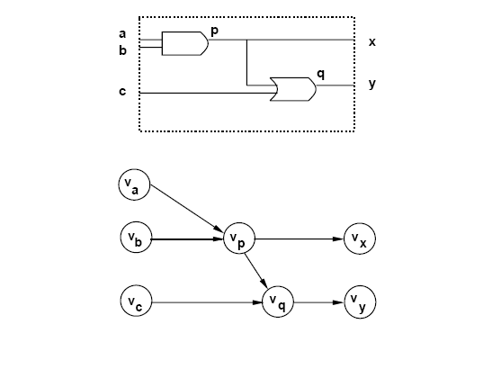
Example of mapped network
Notes:
Note the input, internal and output vertices

Slide 46
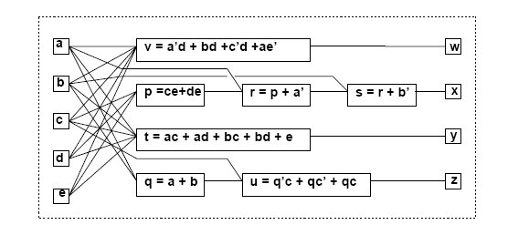
Example of general network
Notes:
Note that blocks may not have a direct implementation

Slide 47
Formal finite-state machine model
A set of primary input patterns X
A set of primary output patterns Y
A set of states S
A state transition function: δ: X × S → S
An output function:
λ: X × S → Y for Mealy models
λ: S → Y for Moore models
Notes:
This is the standard formal definition

Slide 48
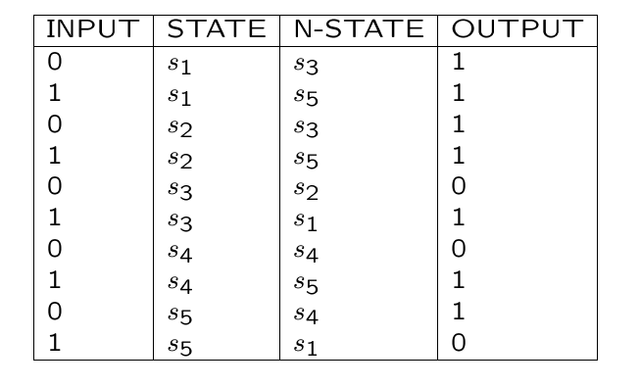
Example
Notes:
The state transition table is a tabulation of the state transition and output functions. Its corresponding graph-based representation is the state transition diagram.

Slide 49
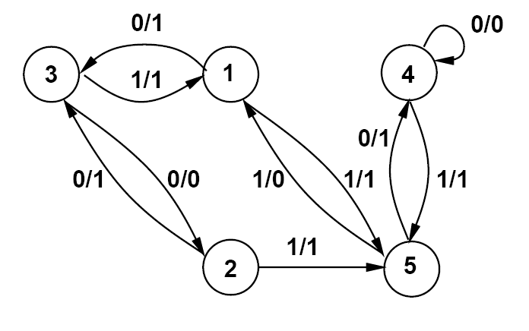
Example
Notes:
Nodes are states. Arcs are transitions. Labels on arcs are of type I/O

Slide 50
Dataflow graphs
Behavioral views of architectural models
Useful to represent data-paths
Graph:
Vertices = operations
Edges = dependencies
Notes:
Data-flow graph} represent operations and data dependencies. Let the number of operations be N.
A data-flow graph is a directed graph whose vertex set V = { v_i ; i = 1 , 2 , … , N} is in one-to-one correspondence with the set of tasks.
We assume here that operations require one ore more operands and yield one or more results (e.g. an addition with two addends yielding a result and an overflow flag.)
The directed edge set E = { ( v_i , v_j ) ; i,j = 1 , 2 , … , N} is in correspondence with the transfer of data from an operation to another one.

Slide 51
Example Differential equation solver -- loop body
diffeq {
read ( x, y, u, dx, a ) ;
repeat {
xl = x + dx;
ul = u – ( 3 . x . u . dx ) – ( 3 . y . dx ) ;
yl = y + u . dx ;
c = x < a ;
x = xl; u = ul; y = yl ;
until ( c );
write ( y )
}

Slide 52
Example
3
x
u
dx
3
y
u
dx
x
dx
1
2
6
8
10
*
*
*
*
+
dx
y
a
x1
3
9
11
7
*
*
+
<
u
4
y1
c
-
5
-
u1

Slide 53
Sequencing graphs
Behavioral views of architectural models
Useful to represent data-path and control
Extended dataflow graphs:
Operation serialization
Hierarchy
Control-flow commands:
Branching and iteration.
Polar graphs:
Source and sink
Notes:
Sequencing graphs add control to dataflow graph, and support hierarchy, branching and iteration.
The first step to obtain a sequencing graph, is to determine the start and end point of the computation, and label these entry/exit nodes as NOPs

Slide 54
Example
0
NOP
1
2
6
8
10
*
*
*
*
+
3
7
9
11
*
*
+
<
4
-
5
-
NOP
n

Slide 55
Example of hierarchy
NOP
a.0
a.1
a.2
*
+
a.3
a.4
*
CALL
b.0
NOP
b.1
b.2
NOP
a.n
*
+
NOP
b.n
Notes:
Call to another graph is represented as a transfer of control from the calling node to the source of the called graph.

Slide 56
Example of branching
NOP
a.0
a.1
a.2
*
+
a.3
a.4
*
BR
b.0
c.0
NOP
NOP
b.1
b.2
a.n
NOP
*
+
c.1
NOP
NOP
b.n
c.n
NOP
Notes:
Branching to multiple targets is represented by having branching bodies encapsulated by specific sequencing graphs entities. Branching is then like a selective call transfer.

Slide 57
Example of iteration
diffeq {
read (x; y; u; dx; a);
repeat {
xl = x + dx;
ul = u – (3 . x . u . dx ;
yl = y + u . dx ;
c = x > a;
x = xl ; u = ul ; y = yl ;
}
until ( c )
write (y) ;
}
Notes:
The sequencing graph is reported inn the next slide

Slide 58
Example of iteration
a.0
NOP
a.1
READ
a.2
LOOP
a.3
WRITE
LOOP BODY
a.n
NOP
Notes:
The loop body is like a repeated model call; the calling node evaluates the exit condition

Slide 59
Semantics of sequencing graphs
Marking of vertices:
Waiting for execution
Executing
Having completed execution
Execution semantics:
An operation can be fired as soon as all its immediate predecessors have completed execution
Notes:
The semantic interpretation of the sequencing graph model requires the notion of marking the vertices.
A marking denotes the state of the corresponding operation, which can be: (i) waiting for execution; (ii) executing; (iii) having completed execution.
Firing an operation means starting its execution. Then, the semantics of the model is as follows: an operation can be fired as soon as all its direct predecessors have completed execution

Slide 60
Vertex attributes
Area cost
Delay cost:
Propagation delay
Execution delay
Data-dependent execution delays:
Bounded (e.g. branching)
Unbounded (e.g. iteration, synchronization)
Notes:
Some attributes can be assigned to the vertices and edges of a sequencing graph model, such as measures or estimates of the corresponding area or delay cost
In general the delay of a vertex can be data-independent or data-dependent.
Only data-independent delays can be estimated before synthesis.
Examples of operations with data-dependent delay are data-dependent delay branching and iteration.
For example, a branch may involve bodies with different delays, where in the limit one branch body can be a NOP (e.g. a floating-point data normalization requiring conditional data alignment.)

Slide 61
Properties of sequencing graphs
Computed by visiting hierarchy bottom-up
Area estimate:
Sum of the area attributes of all vertices
Worst-case – no sharing
Delay estimate (latency):
Bounded-latency graphs
Length of longest path from source to sink
Notes:
A sequencing graph model with data-independent delays can be characterized by its overall delay, called latency.
Graphs with bounded delays (including data-independent) are called bounded-latency graphs.
Else they are called unbounded-latency graphs, because the latency cannot be computed.

Slide 62
Summary
Hardware synthesis requires specialized language support:
VHDL and Syestem Verilog are mainly used today
Similar features
Simulation-oriented
Synthesis from programming languages is also possible:
Hardware and software models of computation are different
Appropriate hw semantics need to be associated with programming languages
SystemC
Abstract models:
Capture essential information
Derivable from HDL models
Useful to prove properties and for algorithm development.

